Slide 1


Prediction of Online News Popularity
Team Members:
Puranikmath, Akash
Balamurugan, Sidharth
Chandra, Manvi
Mankala, Vishwanath

Slide 2


Agenda
Availability of news online is abundant, but the extent of the reach of every news website is the actual challenge. Here we are dealing with a similar subject: The prediction of online news popularity.
As per the dataset, The total number of attributes is 61, and 39,644 Articles published.
In 61 Attributes – 58 Predictive Attributes, 2 Non-Predictive Attributes, and 1 Goal/Target Field

Slide 3

Business Problem
Mashable wants to stand-out from their competitors by improving the influencing factors responsible for news popularity

Slide 4
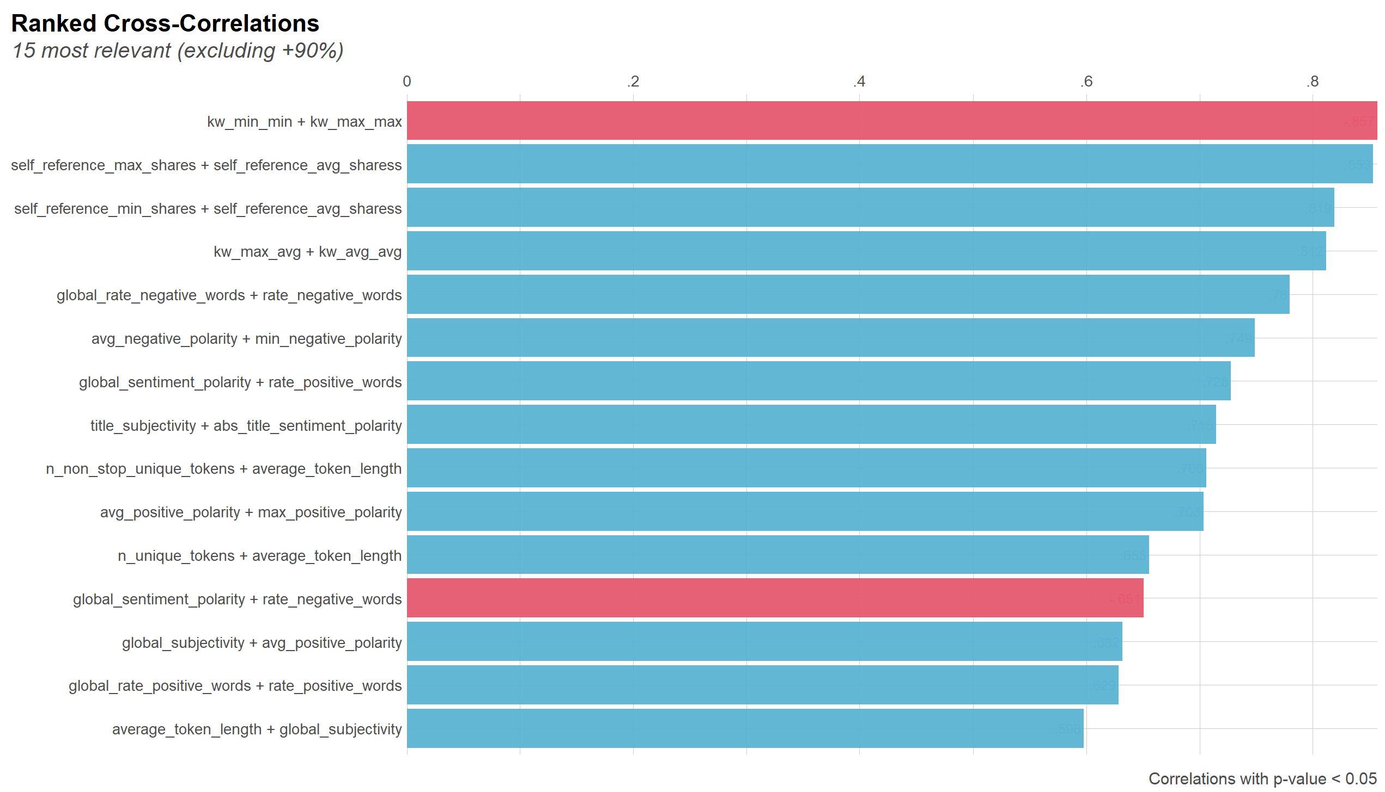
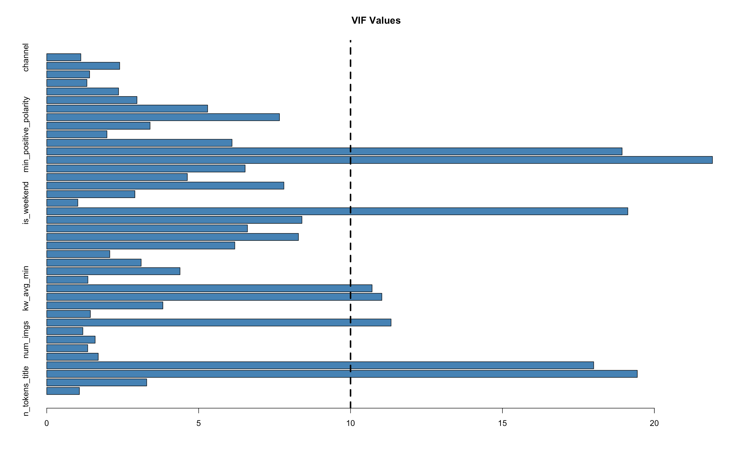
Cross-Correlation of Top 15 Attributes
Correlation
Variance Inflation Factor of Attributes

Slide 5
Feature Selection Techniques
Variance Inflation Factor
Random Forest Classification Algorithm using Boruta Package
Recursive Feature Elimination
Learning Vector Quantization
Feature Selection Techniques
5

Slide 6
Feature Selection Attributes
self_reference_max_shares
Global_subjectivity
global_sentiment_polarity
num_hrefs
is_weekend
global_rate_positive_words
num_imgs
num_keywords
title_sentiment_polarity
max_positive_polarity
n_tokens_title
avg_positive_polarity
kw_max_max
channel
title_subjectivity
num_keywords
num_videos
n_tokens_content
Attributes removed based on following:
Descriptive Analysis
Multicollinearity
Variable Importance
Insufficient Information

Slide 7
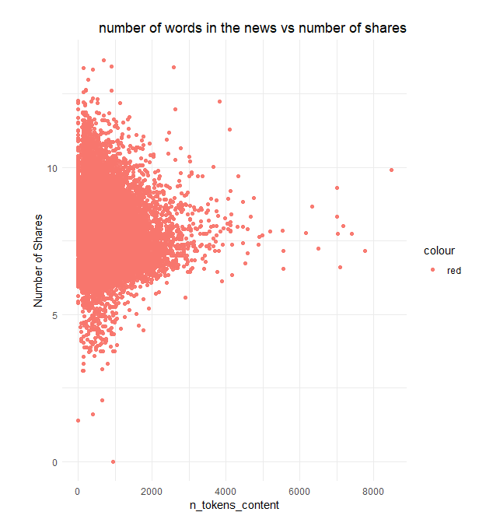
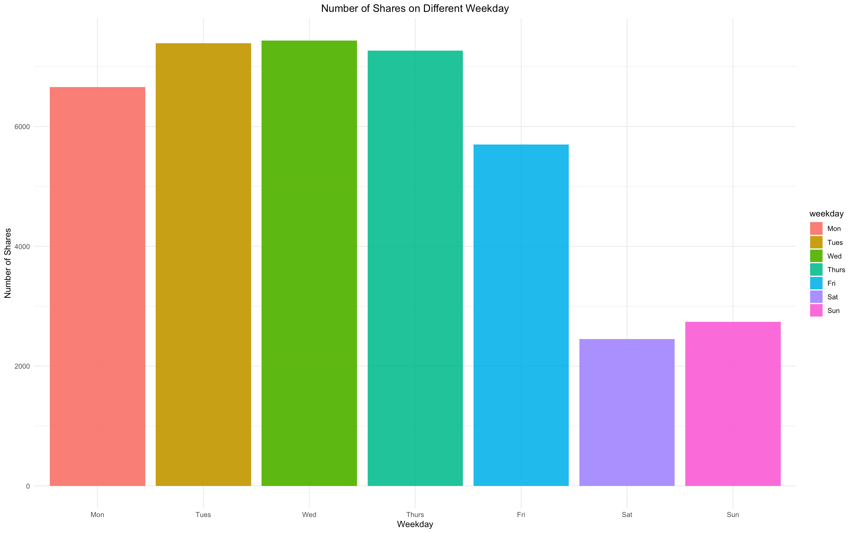
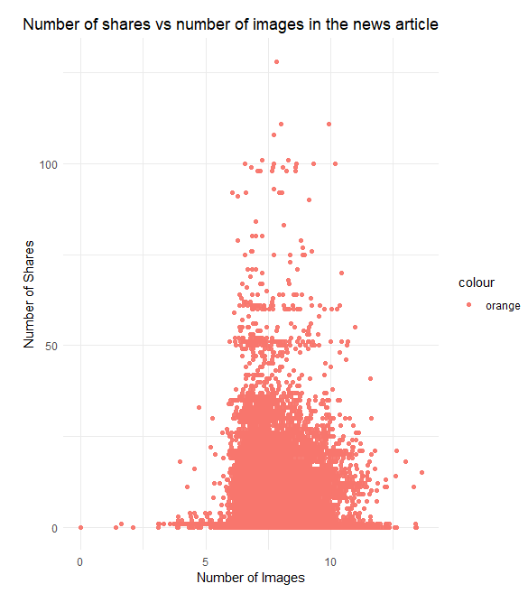
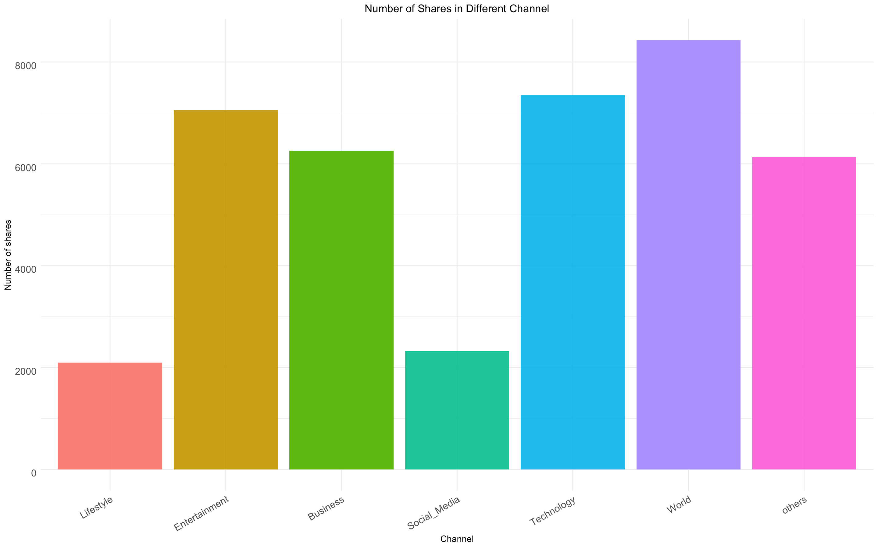
Data Visualization
No. of Shares v/s Number of Token Content
No. of Shares v/s Days of Week
No. of Shares v/s Types of Channel
No. of Shares v/s No. of Images

Slide 8
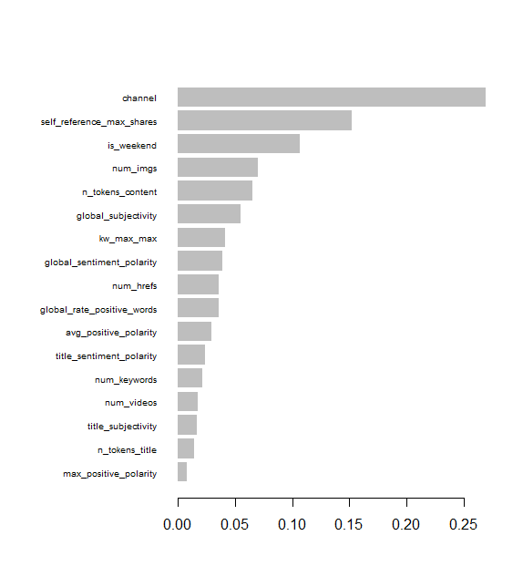
Model Selection
KNN
Model | Training Data |  | Testing Data
Parameters | Accuracy (%) | Sensitivity (%) | Accuracy (%) | Sensitivity (%)
Naïve Bayes | 59 | 34 | 58 | 38
Decision Tree | 63 | 65 | 62 | 65
Random Forest | 65 | 64 | 64 | 64
XGBoost | 66 | 65 | 65 | 63
Confusion Matrix of XGBoost Model
Train Data | Predicted Unpopular | Predicted Popular
Actual Unpopular | 9440 | 4605
Actual Popular | 4796 | 8909
Test Data | Predicted Unpopular | Predicted Popular
Actual Unpopular | 4063 | 1974
Actual Popular | 2167 | 3689
Predictor Importance XG Boost

Slide 9

Business Strategy
Recruitment of younger, informative employees
Collaboration with e-learning platform
Improvement in overall layout of content
Diverse Advertisement
Interactive user experience.
Concise and gripping content.

